Slide 1

Project 1:
ARQ Testing in RLC (Radio Link Control)
Notes:
https://pixabay.com/illustrations/ai-generated-business-office-team-8134654/

Slide 2

Table of Content
01
RLC
Introduction to RLC
04
Code
ARQ Process Code
02
RLC Modes
RLC Modes of Operation
05
Output
03
ARQ
ARQ Process in RLC
06
Conclusion
Notes:
https://pixabay.com/photos/teamwork-cooperation-brainstorming-3213924/

Slide 3

Group Members
Team Members:
Rajeshwari
Swetav
Sujata
Pavan
Prasad
Shashwat
Bhuvaneshwari
Mentor/Guide:
Abhijeet Kumar

Slide 4
Introduction & Overview
The ARQ (Automatic Repeat reQuest) testing in the Radio Link Control (RLC) layer is a crucial aspect of ensuring reliable data transmission in wireless communication networks. This project is focused on implementing and evaluating the ARQ mechanism within the RLC layer to enhance data integrity. By retransmitting lost or corrupted packets, ARQ plays a vital role in minimizing packet loss and maintaining robust communication links.
The project involves simulating various scenarios where packet loss might occur and analyzing the effectiveness of the ARQ mechanism in recovering lost data. It examines how the RLC layer handles retransmissions, monitors the impact on data throughput, and assesses overall network performance. The ultimate goal is to validate the importance of ARQ in improving communication reliability and reducing data transmission errors in the network.
Notes:
https://pixabay.com/photos/architecture-building-ceiling-1850055/

Slide 5
Introduction to RLC
Notes:
https://pixabay.com/photos/architecture-building-ceiling-1850055/

Slide 6
What is RLC
3GPP 38.322
The Radio Link Control (RLC) layer is an integral part of the protocol stack in modern mobile communication systems, such as LTE (Long-Term Evolution) and 5G NR (New Radio). Situated between the Medium Access Control (MAC) layer and the Packet Data Convergence Protocol (PDCP) layer, the RLC layer is responsible for ensuring reliable data transfer and efficient communication over the wireless link.
Radio Link Control (RLC) is a layer 2 Radio Link Protocol used in UMTS, LTE and 5G on the Air Interface. This protocol is specified by 3GPP in TS 25.322 for UMTS, TS 36.322[2] for LTE and TS 38.322 for 5G New Radio (NR). RLC is located on top of the 3GPP MAC layer and below the PDCP layer.
It is essential for adapting to the challenges of wireless communication, such as varying signal strength, interference, and mobility. By handling segmentation, error correction, and flow control, the RLC layer plays a crucial role in ensuring that data is transmitted efficiently and reliably, contributing to the overall performance and quality of service in mobile networks.

Slide 7
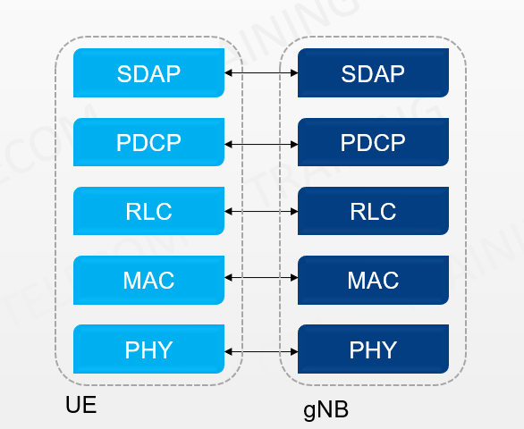
3GPP 38.322
Fig 1.1 Layer Structure

Slide 8
Functions and Services of RLC
4.3, 4.4 of 3GPP 38.322
Functions:
transfer of upper layer PDUs
error correction through ARQ (only for AM data transfer)
segmentation and reassembly of RLC SDUs (only for UM and AM data transfer)
re-segmentation of RLC SDU segments (only for AM data transfer)
duplicate detection (only for AM data transfer)
RLC SDU discard (only for UM and AM data transfer)
RLC re-establishment;
Protocol error detection (only for AM data transfer).
Services provided to upper layers
• TM data transfer
• UM data transfer
AM data transfer, including an indication of successful delivery of upper layers PDUs.
Services provided from lower layers
Data transfer
Notification of a transmission opportunity, together with the total size of the RLC PDU(s) to be transmitted in the transmission opportunity

Slide 9
RLC Modes of Operation
Notes:
https://pixabay.com/photos/architecture-building-ceiling-1850055/

Slide 10
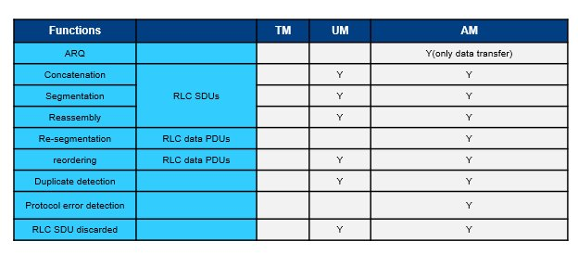
Radio Link Control Modes
4.2.1.1, 4.2.1.2, 4.2.1.3 of 3GPP 38.322
1.Transparent Mode (TM):
Do not require any error correction or
retransmission.
No RLC header is applied
Directly maps with RLC SDU to an RLC PDU
Logical Channels: BCCH, DL/UL CCCH, and
PCCH
2.Unacknowledged Mode (UM):
RLC header and sequence numbers added to
each PDU
supports segmentation, no retransmission.
Logical Channels: DL/UL DTCH
3. Acknowledged Mode (AM):
Error correction with ARQ
supports segmentation and concatenation
acknowledgments and flow control
Logical Channels: DL/UL DCCH or DL/UL DTCH
Fig 2.2 RLC Modes and its functions

Slide 11
ARQ Process in RLC
Notes:
https://pixabay.com/photos/architecture-building-ceiling-1850055/

Slide 12
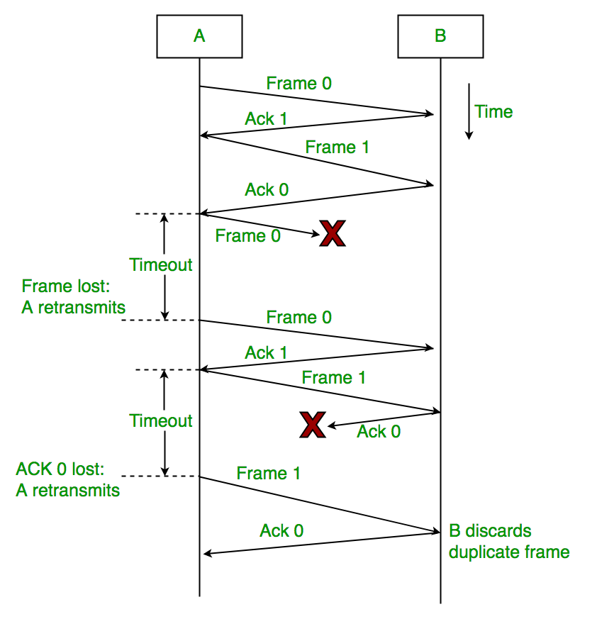
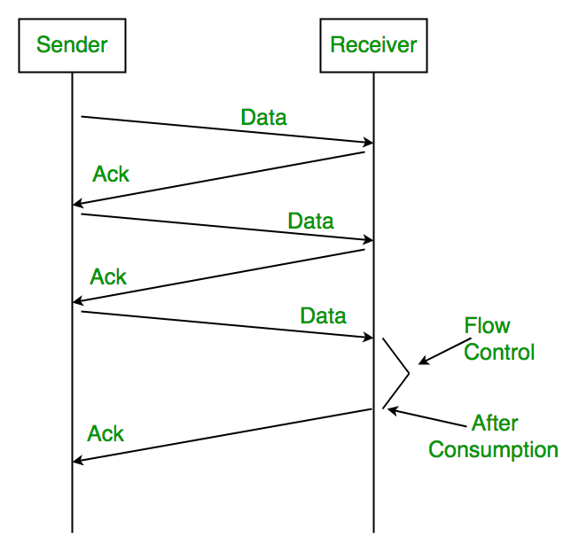
Fig 3.1 ARQ Process

Slide 13
ARQ Process
3GPP 38.322
ARQ is a protocol for error detection and correction in data communication systems. It ensures reliable data transmission by automatically requesting the retransmission of any corrupted or lost data packets
How ARQ Works in RLC:
Data Transmission:
Data is sent from the transmitter to the receiver in the form of Protocol Data Units (PDUs).
Each PDU contains a sequence number that allows the receiver to detect missing or out-of-order PDUs.
Error Detection:
The receiver checks each PDU for errors using mechanisms like Cyclic Redundancy Check (CRC).
If a PDU is received correctly, the receiver sends an acknowledgment (ACK) back to the transmitter.
Negative Acknowledgment (NACK):
If an error is detected or a PDU is missing, the receiver sends a Negative Acknowledgment (NACK) to the transmitter.
The NACK indicates that specific PDUs need to be retransmitted.
Retransmission:
Upon receiving a NACK, the transmitter resends the requested PDUs.
This process continues until the receiver successfully receives all PDUs, or until a maximum number of retransmissions is reached.

Slide 14
3GPP 38.322
Types of ARQ Mechanisms:
Stop-and-Wait ARQ:
The simplest form of ARQ.
The transmitter sends one PDU and waits for an ACK or NACK before sending the next PDU.
Pros: Simple to implement.
Cons: Inefficient for high-latency links as it leads to idle time between transmissions.
Go-Back-N ARQ:
The transmitter can send several PDUs before needing an acknowledgment.
If an error is detected, all subsequent PDUs are retransmitted, starting from the failed PDU.
Pros: Improves efficiency over Stop-and-Wait.
Cons: Can lead to significant retransmission overhead.
Selective Repeat ARQ:
Only the erroneous or missing PDUs are retransmitted.
Requires the receiver to maintain a buffer for out-of-order PDUs.
Pros: Reduces unnecessary retransmissions, improving efficiency.
Cons: More complex to implement due to the need for managing out-of-order data.

Slide 15
3GPP 38.322
Advantages of ARQ in RLC:
Reliability: Ensures that data is delivered correctly, improving the quality of service.
Error Correction: Automatically handles errors, reducing the need for manual intervention.
Efficiency: Selective Repeat ARQ, in particular, optimizes data transmission, reducing bandwidth wastage.
Dis-Advantages of ARQ in RLC:
Latency: Retransmissions can introduce delays, particularly in time-sensitive applications.
Resource Utilization: ARQ mechanisms require additional processing and memory resources, especially for Selective Repeat ARQ.

Slide 16
Code
Notes:
https://pixabay.com/photos/architecture-building-ceiling-1850055/

Slide 17
Code
Demonstration of ARQ Process in C++ Code
Source: GitHub, Linked In

Slide 18
Output
Notes:
https://pixabay.com/photos/architecture-building-ceiling-1850055/

Slide 19
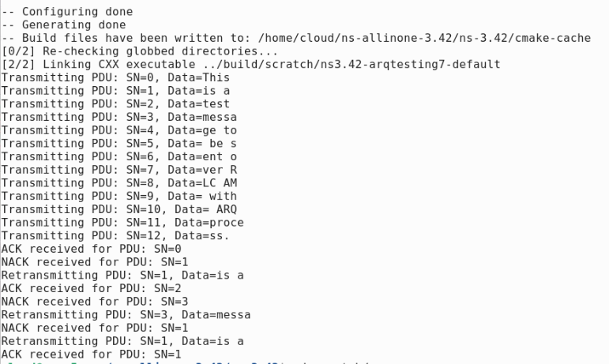
Output
Fig 4.1 Code Output

Slide 20
Thank You!
Team Members:
Rajeshwari
Swetav
Sujata
Pavan
Prasad
Shashwat
Bhuvaneshwari
Notes:
https://pixabay.com/photos/architecture-building-ceiling-1850055/

